Slide 1
Decision Trees
Varol Kayhan, PhD

Slide 2
Introduction
Used for both classification and regression
Performs well in various contexts (including non-linear relationships)
Doesn’t require much technical knowledge
Easily interpreted (WHITE BOX)
Creates rules

Slide 3
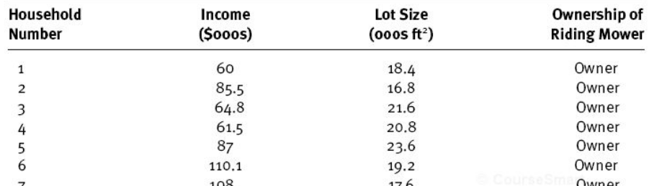
Classification Task - Example
Example: (Imagine this is the TRAIN set)
Two predictors
(two dimensions)
Target variable
(12 owners;
12 non-owners)

Slide 4
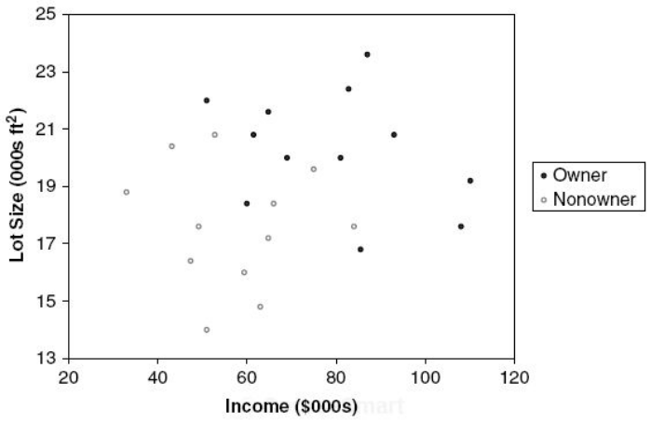
Classification Task - Example
Step 1: Create a scatterplot

Slide 5
Classification Task - Example
Step 2: Draw a vertical or horizontal line to increase the "purity" (or homogeneity) of each resulting space
Owners: 12
Non-owners: 12
Lot size
≤19
>19
Owners: 3
Non-owners: 9
Owners: 9
Non-owners: 3

Slide 6
Classification Task - Example
If you stop here: use the "majority" rule
Owners: 12
Non-owners: 12
Owners: 12
Non-owners: 12
Lot size
Lot size
≤19
>19
≤19
>19
Owners: 3
Non-owners: 9
Owners: 9
Non-owners: 3
NON-OWNER
OWNER
Which observations are misclassified?
What is the accuracy?

Slide 7
Classification Task - Example
Step 3: Draw another vertical or horizontal line to increase the "purity" (or homogeneity)
Owners: 12
Non-owners: 12
Lot size
≤19
>19
Owners: 3
Non-owners: 9
Owners: 9
Non-owners: 3
Income
≤84.75
>84.75
Owners: 1
Non-owners: 9
Owners: 2
Non-owners: 0

Slide 8
Classification Task - Example
If you stop here: use the "majority" rule
Owners: 12
Non-owners: 12
Owners: 12
Non-owners: 12
Lot size
Lot size
≤19
>19
≤19
>19
Owners: 3
Non-owners: 9
Owners: 9
Non-owners: 3
Owners: 3
Non-owners: 9
OWNER
Income
Income
≤84.75
>84.75
≤84.75
>84.75
Owners: 1
Non-owners: 9
Owners: 2
Non-owners: 0
NON-OWNER
OWNER

Slide 9
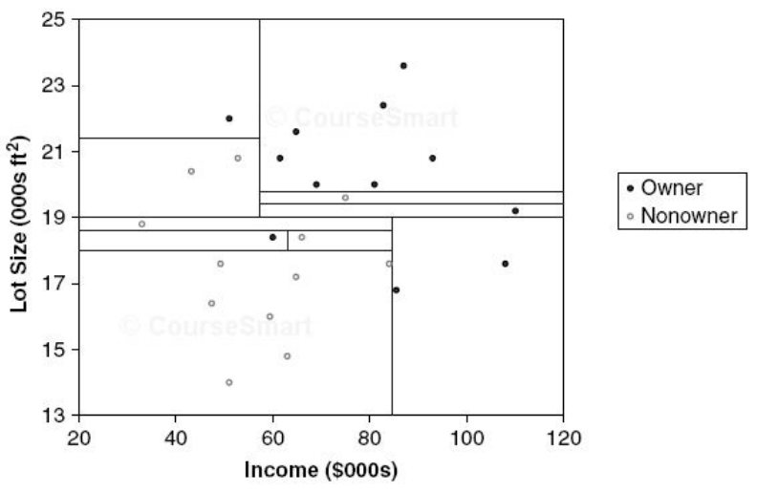
Classification Task - Example
Step 4: Continue until each resulting space is homogeneous
No cell has any "impurity"
What is the risk of eliminating all impurities?

Slide 10
Recursive Partitioning (CART)
How does the algorithm identify the split points:
Variable 1
(Income)
Variable 2
(Lot size)
Variable 3
(…)
Try all splits
Try all splits
Find the reduction in "impurity" after each split
Find the reduction in "impurity" after each split
When does it stop:
Either: hit the max depth
Or: there is no improvement in reducing impurity
Rank the results
repeat
Select the best

Slide 11
Recursive Partitioning (CART)
Scikit uses CART
CART is a greedy algorithm
Creates a split and moves on
Doesn’t go back to the previous split to see if it would lead to lowest impurity
It may not converge on the optimal solution (but “reasonably” close to it)
CART can do only two-way split
(No three-way splits)
ID3 algorithm can do three-way splits

Slide 12


Reduction in "Impurity"
Two impurity measures:
Gini index:
Entropy:
Possible to get different results depending on the measure selected! (However, they usually agree on the same split)
p: proportion of observations in rectangle 1 that belongs to class k

Slide 13
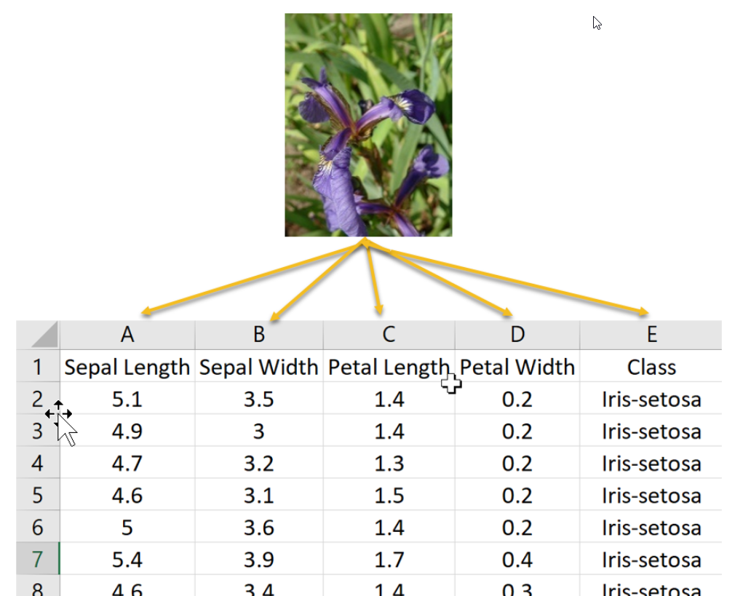
Tree Structure – SciKit version
Iris data set: (multiclass)
Source: oreilly.com

Slide 14
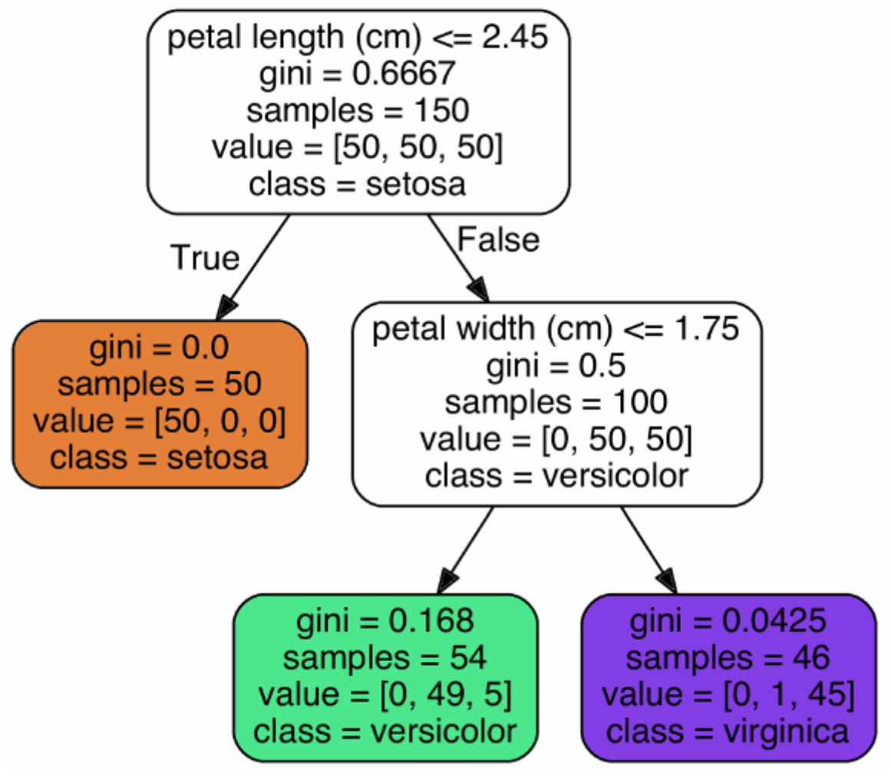
Tree Structure – SciKit version
Iris data set: (multiclass)
Root node
# of obs. in each class:
[Setosa, versicolor, virginica]
Split variable (and condition)
Gini “impurity” index =
1 – [(0/46)² + (1/46)² + (45/46)²]= 0.0425
Leaf node
(terminal node)
Classification

Slide 15
Tree Structure – SciKit version
Class probabilities:
# of obs. in each class:
[Setosa, versicolor, virginica]
Setosa probability: 0%
Versicolor probability: 91%
Virginica probability: 9%

Slide 16
Decision Tree
How do we classify a new observation?
Decision node
Decision node
Leaf node
(e.g. 1)
Leaf node
(e.g. 0)
Leaf node
(e.g. 1)
Leaf node
(e.g. 1)
Leaf nodes are "terminal" nodes!

Slide 17
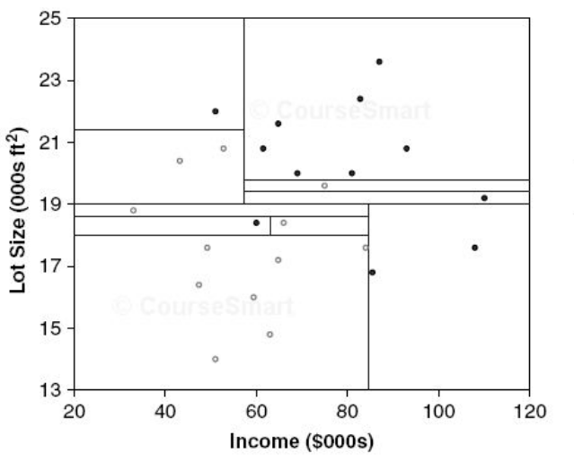
Overfitting
Too much splits cause overfitting:
Overfitting
Fewer splits?
versus

Slide 18
How to Avoid Overfitting
“Regularization” (restrictions) using hyperparameters:
Max_depth: how far can the tree go (default is unlimited)
Min_samples_split: min # of obs. a node must have before a split
Min_samples_leaf: min # of obs. a leaf node must have
Min_weight_fraction_leaf: fraction of min_samples_leaf
Max_leaf_nodes: max # of leaf nodes
Max_features: max # of features examined at each node

Slide 19
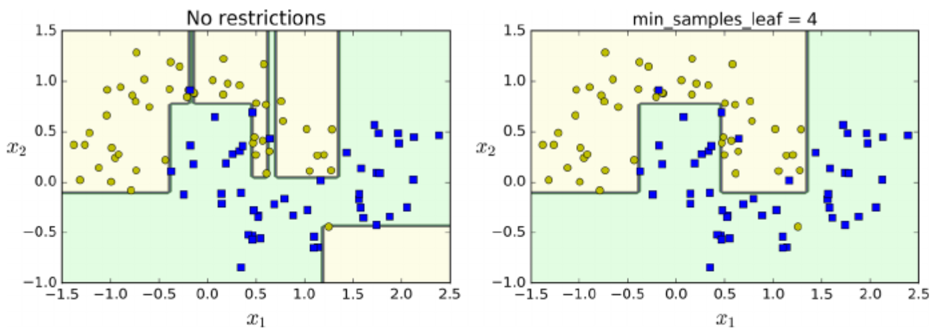
Regularization

Slide 20
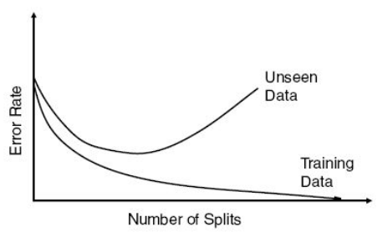
Avoid Overfitting
Write code in Python:
Tree size | Training error rate | Validation error rate
… | … | …
9 | 2.2 | 1.67
10 | 1.6 | 1.67
11 | 1.2 | 1.47
12 | 1.2 | 1.60
13 | 1.2 | 1.60
14 | 1.16 | 1.70
… | … | …
Optimal size
(validation data)

Slide 21
Decision Trees - Regression
Target variable is continuous
Procedure is the same:
Create splits
Instead of "impurity", minimize mean squared error
Take the "average" of the target variable in the leaf node
Disadvantage of Regression Trees: they generate the same value for each observation at the leaf node!

Slide 22
Prediction Decision Tree – Example
Example: (Consider this the TRAIN set)
Value of Mower
$4,000
$3,000
$2,500
$1,500
$4,500
$5,200
Two predictors
(two dimensions)
Target variable
(price of mower)

Slide 23
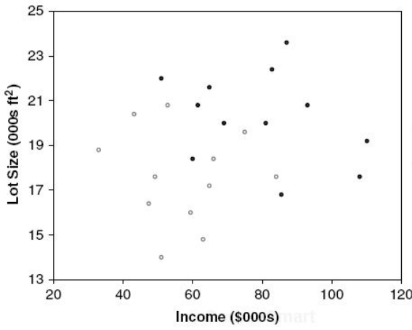
Prediction Decision Tree – Example
Example:
Ave=$6,240
$1,200
Lot size
≤19
>19
$1,500
$1,000
Ave=…
Ave=…
$3,000
Income
$11,000
$3,500
≤84.75
>84.75
$10,000
$12,000
Ave=…
Ave=$3,250

Slide 24
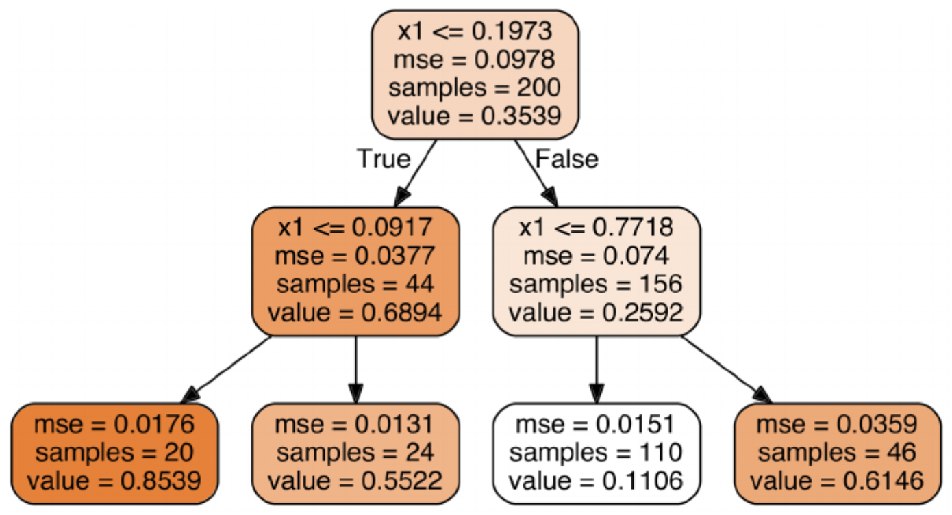
Tree Structure: Scikit version

Slide 25
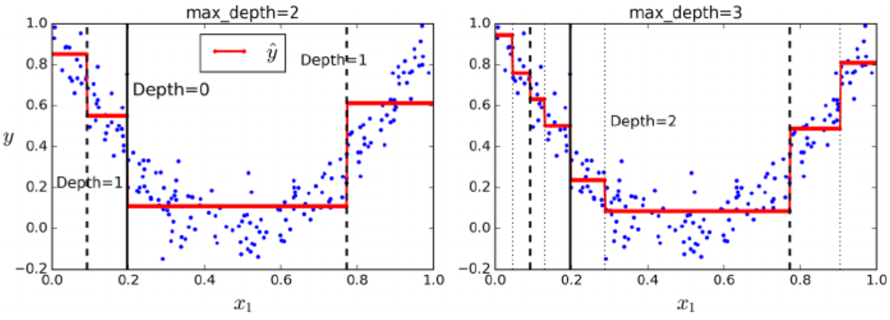
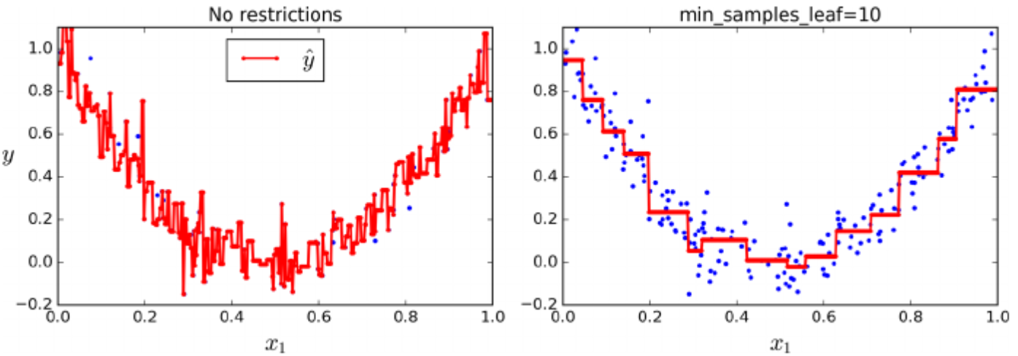
Can Fit Non-linear Models

Slide 26
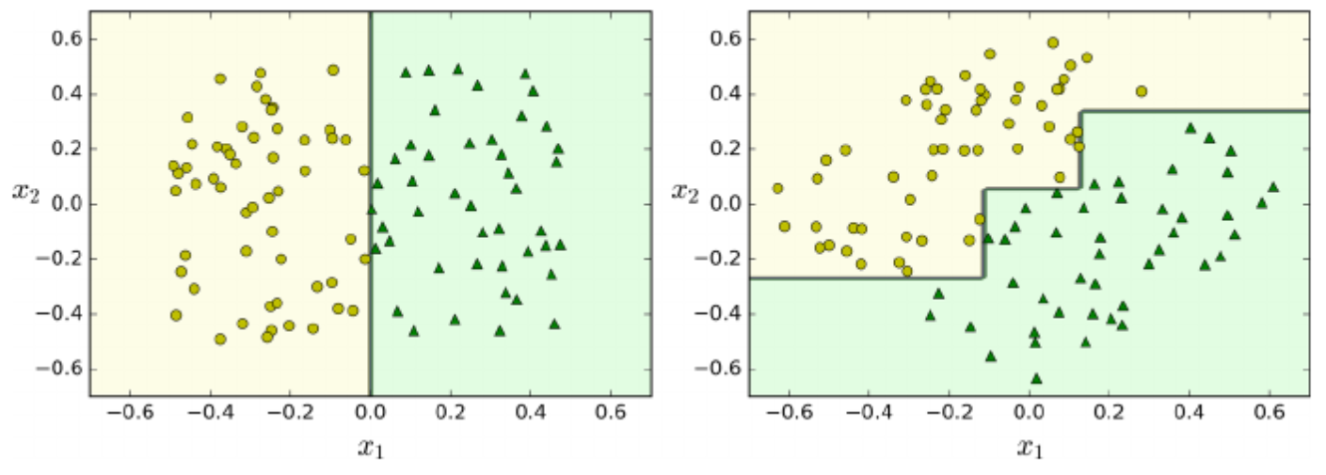
Rotation of the training data
Decision trees use only vertical and horizontal lines!
If variables are not orthogonal, trees get complex!
Instead, you can use PCA (orthogonal variables)
What is the problem with this?
Data is rotated by 45 degrees
Orthogonal
variables
Non-orthogonal
variables

Slide 27
Advantages of Trees
Accurate and good prediction
Very easy to use
Creates understandable rules (white box)
Can be used for variable reduction (choose only the variables used for splits)
Performs variable selection automatically
Not sensitive to outliers
Can detect various non-linear relationships
Can handle missing values

Slide 28
Disadvantages of Trees
Uses only horizontal or vertical lines. Cannot use diagonal lines.
Requires large data sets
Can be computationally expensive
Susceptible to overfitting!!!

